Slide 1
Module-5: FILE PROCESSING :
Files: Types of file processing: Sequential access, Random access Sequential access file - Random access file - Command line arguments.

Slide 2
Files and File Processing in C
What is a File?
A file is a collection of related data stored on a storage device (such as a hard disk or SSD). Instead of using input/output (I/O) operations directly from memory, files allow persistent storage of data, which can be retrieved and modified later.
In C, file handling is performed using the standard C library <stdio.h>, which provides functions for reading, writing, and manipulating files.

Slide 3
Types of Files in C
Text Files
  Stores data in human-readable form (ASCII characters).
  Can be opened and edited with a text editor.
  Example: .txt, .csv
Binary Files
  Stores data in machine-readable form (binary format).
  More efficient and faster than text files.
  Example: .bin, .dat

Slide 4
File Operations: C provides several operations to handle files:
Opening a File (fopen())
  A file must be opened before any operation (read/write) is performed.
Closing a File (fclose())
  A file should be closed after completing operations to free up system resources.
Reading from a File (fscanf(), fgets(), fread())
  Retrieves data from a file.
Writing to a File (fprintf(), fputs(), fwrite())
  Stores data in a file.
Appending to a File (a mode in fopen())
  Adds data to the end of an existing file.

Slide 5
File Handling Functions in C
Function | Description
fopen() | Opens a file in a specified mode
fclose() | Closes an opened file
fprintf() | Writes formatted data to a file (text)
fscanf() | Reads formatted data from a file (text)
fgets() | Reads a string from a file
fputs() | Writes a string to a file
fwrite() | Writes binary data to a file
fread() | Reads binary data from a file
fseek() | Moves the file pointer to a specific location
ftell() | Returns the current file pointer position
rewind() | Resets file pointer to the beginning

Slide 6
File Opening Modes in C:
Mode | Description
"r" | Open for reading (file must exist)
"w" | Open for writing (creates a new file or overwrites existing)
"a" | Open for appending (creates a new file if it does not exist)
"r+" | Open for both reading and writing (file must exist)
"w+" | Open for reading and writing (overwrites existing file)
"a+" | Open for reading and appending

Slide 7

FILE Data Type:
FILE is a data type in C that is used to represent a file stream. It is defined in the <stdio.h> header file.
Understanding FILE in C
FILE is a structure (struct) that stores information about an opened file, such as:
  The file name
  The current position of the file pointer
  The file mode (read, write, append, etc.)
  The status of the file (open/closed)
  Error indicators
When you declare a pointer to FILE, such as:
It means file is a pointer to a structure that contains file-related information.

Slide 8
How FILE Works:
fopen("example.txt", "w") : opens the file "example.txt" in write mode (w).
It returns a pointer to a FILE structure, which is stored in file.
If the file fails to open (e.g., due to permission issues), fopen() returns NULL.

Slide 9
⚠️ Why You Can't Print or Access FILE Structure Directly Using printf
The FILE structure in C is opaque, meaning its internal members are hidden from user programs. You cannot access or print its internal structure directly using printf, because:
The C standard does not define the internal layout.
It is implementation-specific (varies across compilers and platforms).
You are only supposed to manipulate FILE * via standard library functions (like fopen(), fclose(), fread(), fwrite(), etc.).

Slide 10
Writing to a File (fprintf(), fputs(), fwrite())
1. fprintf() – Formatted Output to a File
fprintf() is used to write formatted text (similar to printf(), but for file output). You can specify the format for the data, such as integers, strings, floating-point numbers, etc.
Syntax:
file → Pointer to the file where data is written.
format → Format specifiers (%d, %s, %f, etc.).
Returns the number of characters written or a negative number on error.

Slide 11
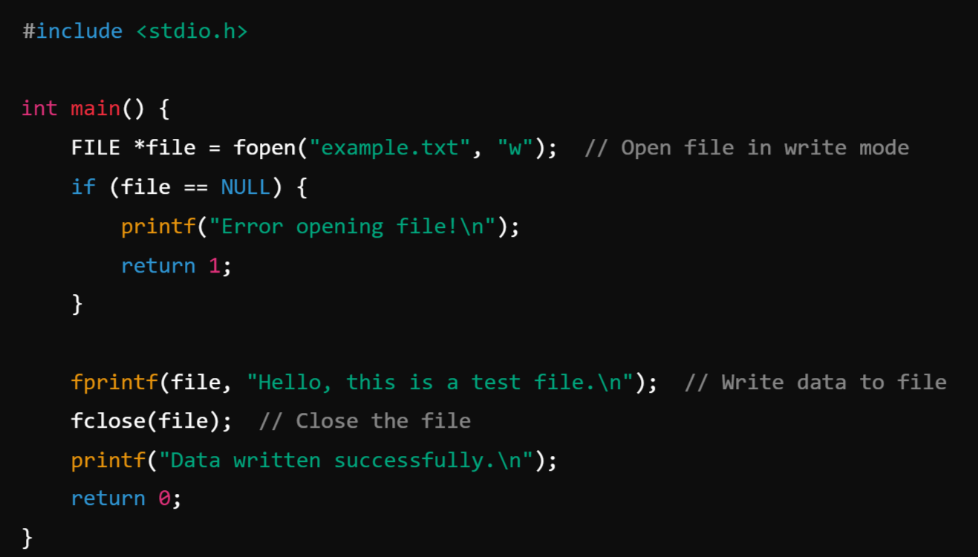
Example

Slide 12

2. fputs() – Writing a String to a File
fputs() is used to write a string (without formatting) to a file. It writes the string exactly as it is, including spaces, but does not add a newline at the end.
Syntax:
str → The string to be written to the file.
file → Pointer to the file.
Returns a non-negative value if successful, or EOF on error.

Slide 13
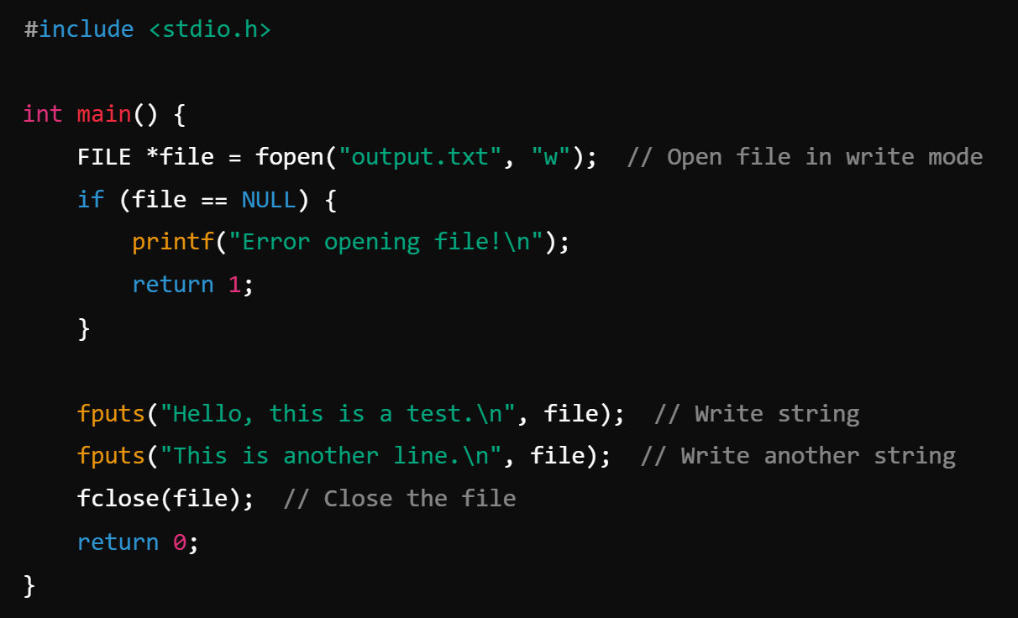

Example

Slide 14
3. fwrite() – Writing Binary Data to a File
fwrite() is used to write raw binary data to a file. It writes data as blocks of memory, which can be useful for saving complex data types like structs, images, or arrays.
Syntax:
ptr → Pointer to the data you want to write.
size → Size of each element (e.g., sizeof(int)).
count → Number of elements to write.
file → Pointer to the file.
Returns the number of elements successfully written.

Slide 15
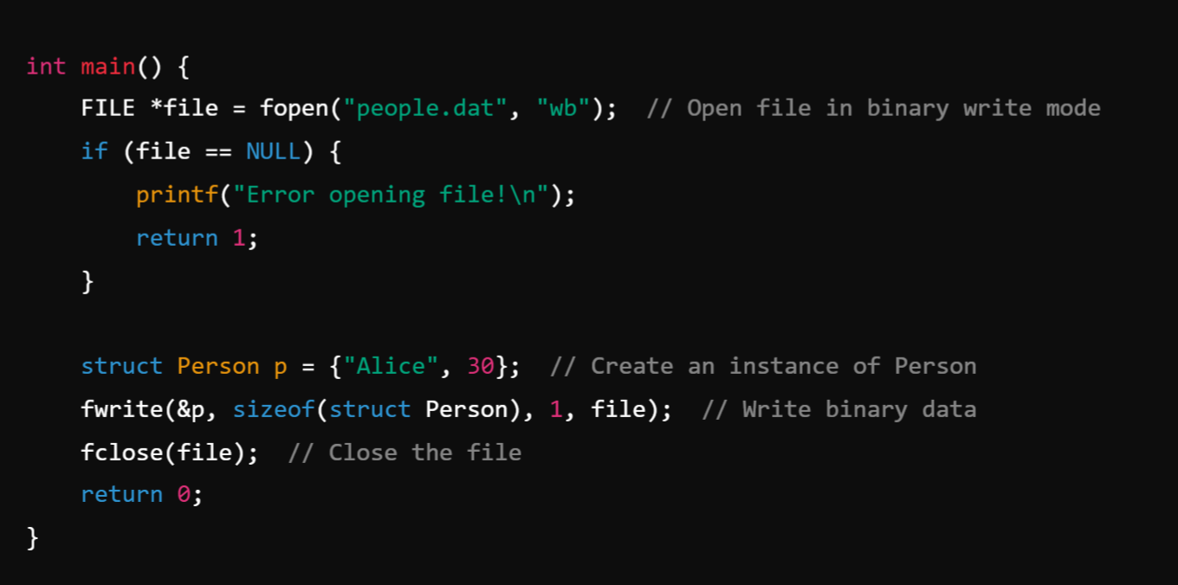
Example
Example:

Slide 16
Reading from a File (fscanf(), fgets(), fread())
1. fscanf() – Formatted Input from a File
fscanf() is used to read formatted data from a file, similar to scanf() but for file input.
Syntax:
file → Pointer to the file opened in read mode.
format → Specifies the format specifier (%d, %s, %f, etc.).
Returns the number of items successfully read, or EOF (-1) on failure.

Slide 17
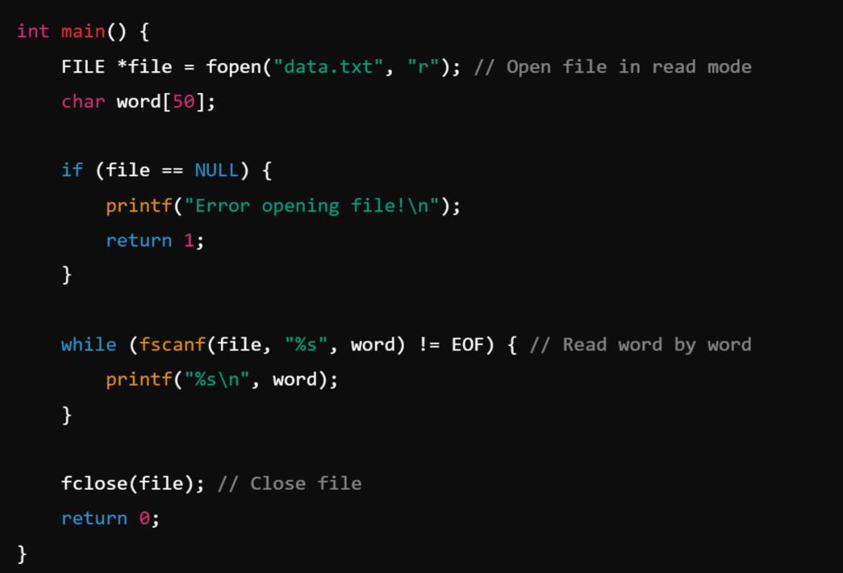
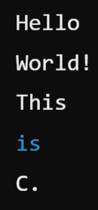
Example: –
Read words from a file.
📌 Output (if data.txt contains "Hello World! This is C."):

Slide 18
2. fgets() – Read a Line from a File
fgets() is used to read an entire line (including spaces) from a file.
Syntax:
str → Character array to store the line.
size → Maximum number of characters to read (including \0).
file → Pointer to the file.
Returns NULL if end of file or error occurs.

Slide 19
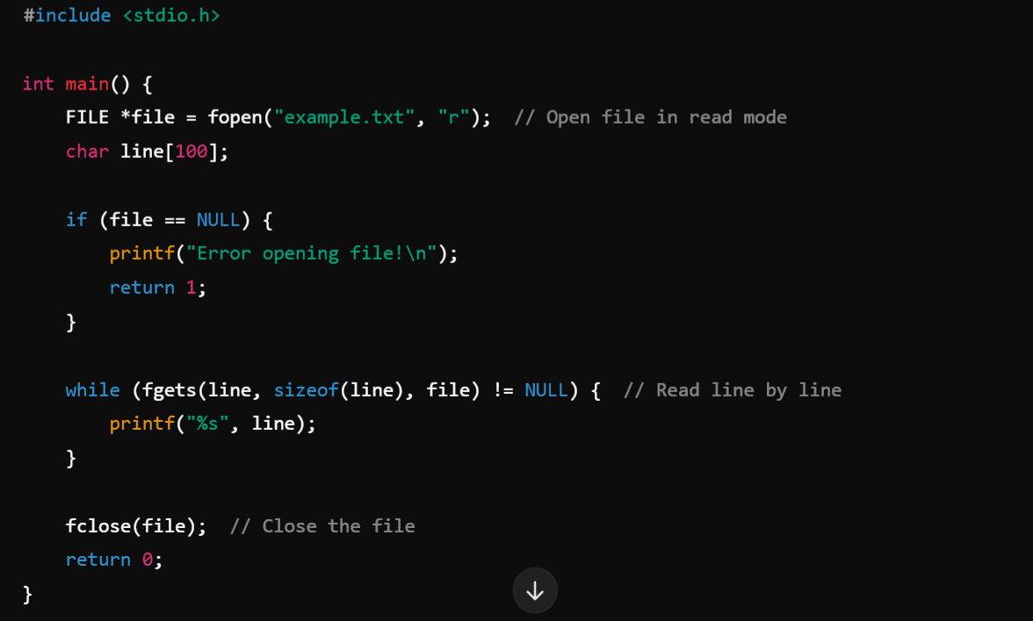
Example

Slide 20
3. fread() – Read Binary Data from a File
fread() is used to read raw binary data (useful for images, structures, etc.).
Syntax:
ptr → Pointer to buffer where data is stored.
size → Size of each element.
count → Number of elements to read.
file → File pointer.
Returns number of elements read.

Slide 21
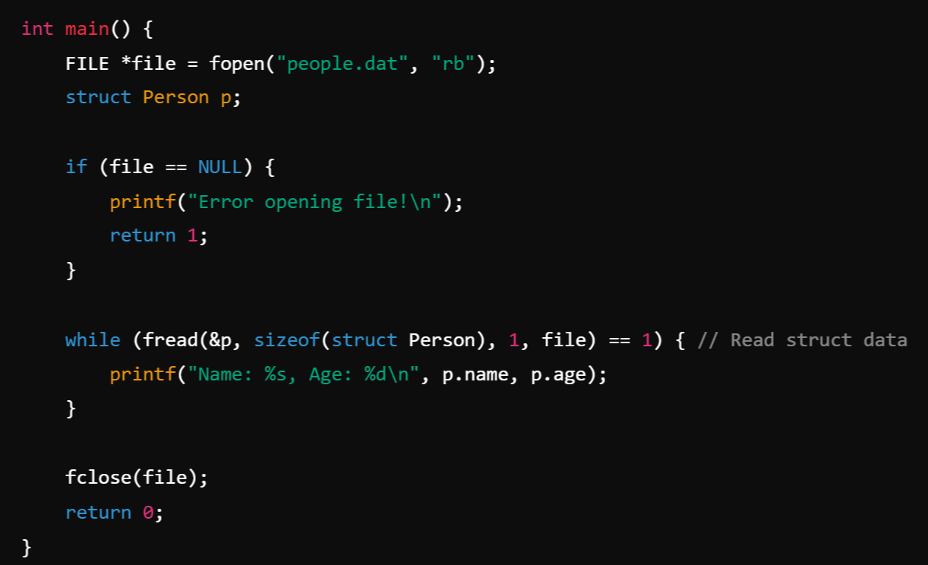

Example – Read binary data

Slide 22
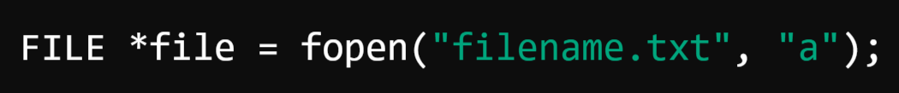
3. Appending to a File in C (a mode in fopen())
Appending to a file means adding new content without overwriting the existing data. In C, you can use the "a" mode in fopen() to achieve this.
When opening a file in append mode:
If the file exists, new data is added at the end of the file.
If the file does not exist, it is created automatically.
Unlike "w" mode, "a" does not erase the file’s previous contents.
Syntax:

Slide 23
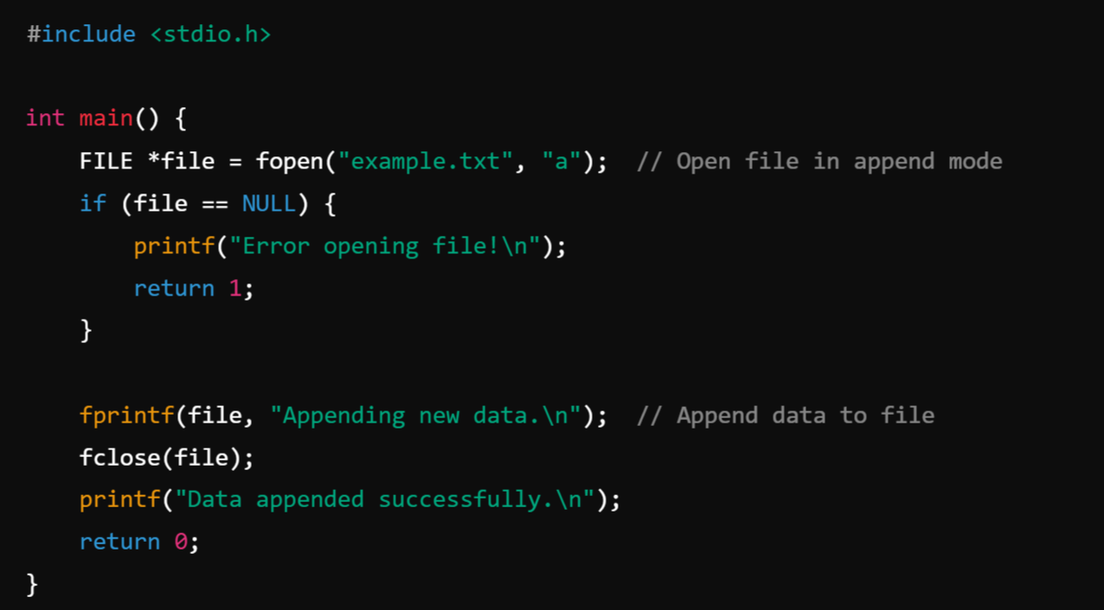
Example

Slide 24
Types of File Processing in C:
File processing in C refers to the ability to read from and write to files using the Standard I/O library (stdio.h). Instead of handling input and output through the console, file processing allows programs to store data persistently in files.
File processing in C is used to store and retrieve data efficiently. C provides different types of file processing methods, mainly:
Sequential File Processing
Random (Direct) File Processing
Indexed File Processing
Hashed File Processing

Slide 25
Sequential File Processing:
Sequential access means reading or writing data in order, from the beginning to the end of a file. Data is accessed one record at a time, and you cannot skip directly to a specific position without reading all previous records.
It is similar to reading a book page by page rather than jumping directly to a particular chapter.
📌 Characteristics of Sequential Access
✔ Linear Processing → Data is processed in the order it is stored.
✔ No Direct Jumping → You must read all prior records to access a specific one.
✔ Efficient for Logs and Reports → Best suited for files where records are always processed sequentially.
✔ Simple to Implement → Requires basic file operations like fopen(), fgets(), fprintf(), etc.
✔ Slower for Large Files → If you need to access a record in the middle, sequential access is inefficient.

Slide 26
1️⃣ Writing Data Sequentially to a File
In sequential writing, data is written one after another in the order they are provided.
📌 Example – Writing Names and Ages to a File
🔹 Explanation
The file is opened in write mode (w).
fprintf() writes data line by line.
The file is then closed to ensure data is saved.

Slide 27
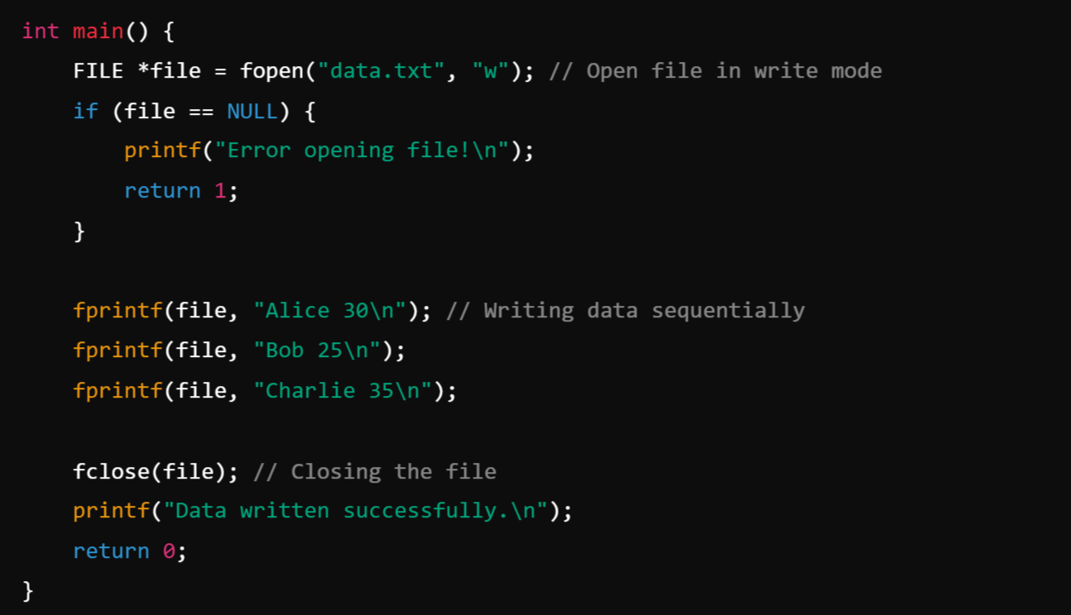

Slide 28
2️⃣ Reading Data Sequentially from a File:
When reading, we start from the beginning and move forward line by line.
📌 Example – Reading Names and Ages from a File
🔹 Explanation
The file is opened in read mode (r).
fscanf(file, "%s %d", name, &age) reads data word by word.
Loop continues until EOF (End of File) is reached.

Slide 29

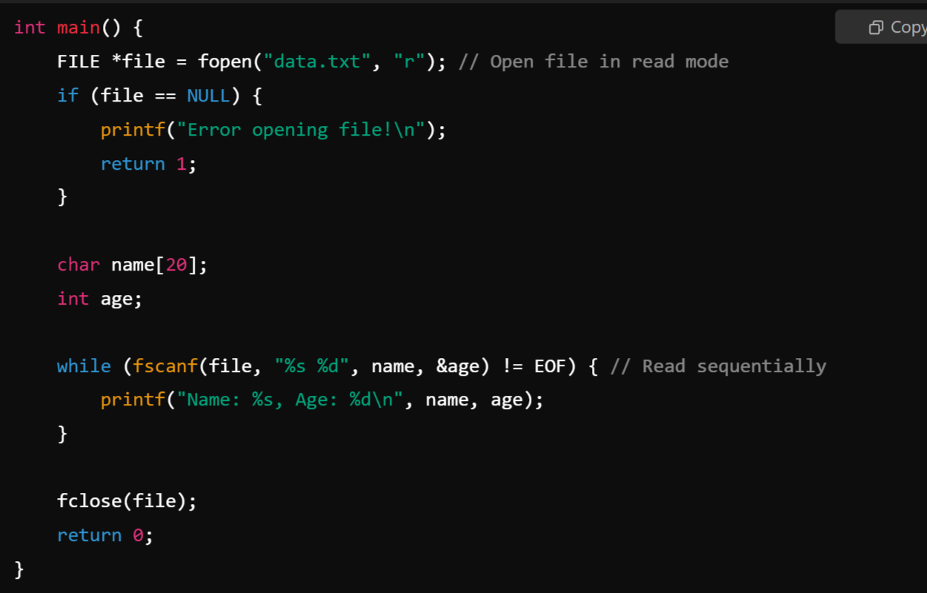

Slide 30
3️⃣ Appending Data Sequentially to a File
Appending means adding data at the end without overwriting the existing content.
📌 Example – Adding More Entries to an Existing File
🔹 Explanation
The file is opened in append mode (a).
New entries do not overwrite existing data.
fprintf() writes at the end of the file.

Slide 31
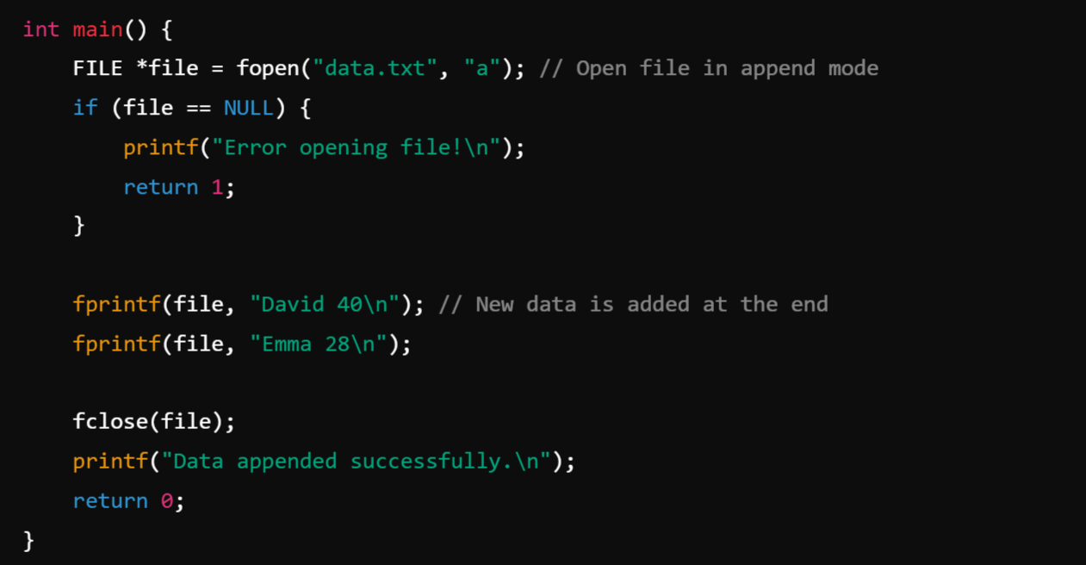

Slide 32
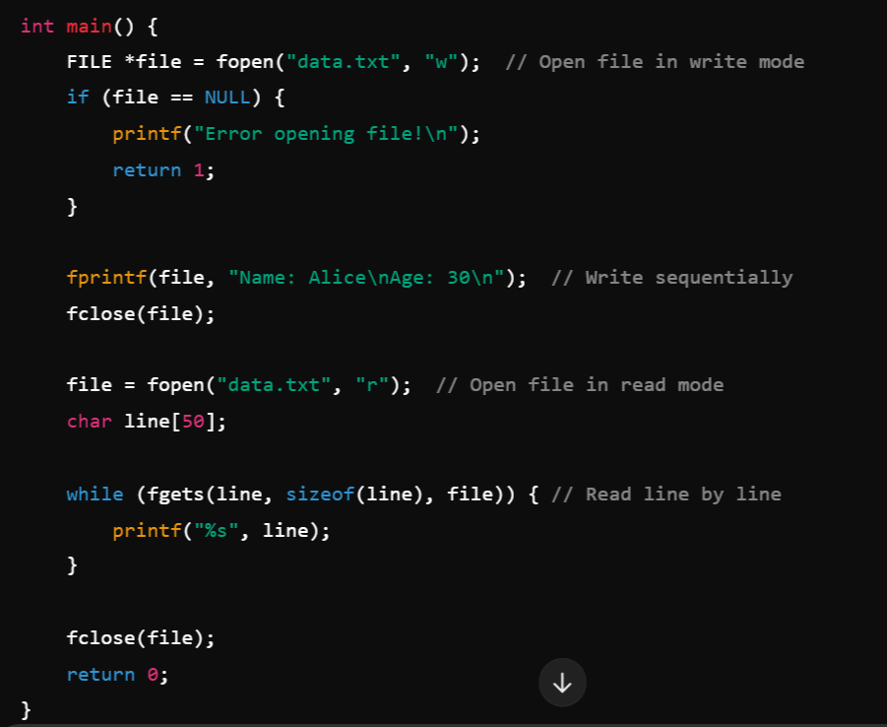
📌 Example – 2
Writing and Reading Sequentially
🔹 Explanation
The file is opened in write mode (w), and data is written sequentially.
Then, it is opened in read mode (r), and data is read line by line using fgets().

Slide 33
2. Random (Direct) File Processing:
Random access (or direct access) in file processing allows you to jump to any position in a file without reading it sequentially. This makes it faster and more efficient when dealing with large files where you need to read or modify specific data.
📌 Key Features of Random Access:
✔ Fast Retrieval → You can directly access any part of the file.
✔ Efficient Updates → Modify only required data without rewriting the entire file.
✔ Works with Both Text & Binary Files → Used for databases, indexing, and fast lookups.
✔ Uses File Positioning Functions → fseek(), ftell(), rewind() are commonly used.

Slide 34
1️⃣ File Positioning Functions
To enable random access, C provides several functions:
📌 fseek(FILE *fp, long offset, int origin);
Moves the file pointer to a specified position.
offset → Number of bytes to move.
origin → Starting point (SEEK_SET, SEEK_CUR, SEEK_END).
Macro | Value | Meaning
SEEK_SET | 0 | Move relative to the start of the file
SEEK_CUR | 1 | Move relative to the current position
SEEK_END | 2 | Move relative to the end of the file

Slide 35
📌 ftell(FILE *fp);
Returns the current position of the file pointer.
📌 rewind(FILE *fp);
Moves the file pointer back to the beginning of the file.

Slide 36
2️⃣ Writing Data Using Random Access
In random access, you can overwrite or insert data at any position.
📌 Example – Writing Student Records at Specific Positions
🔹 Explanation
fseek(file, sizeof(struct Student) * 1, SEEK_SET); moves to the 2nd record position.
fwrite(&s2, sizeof(struct Student), 1, file); writes Bob at 2nd position.
fseek(file, sizeof(struct Student) * 0, SEEK_SET); moves back to 1st record.
This ensures random access instead of sequential writing.

Slide 37

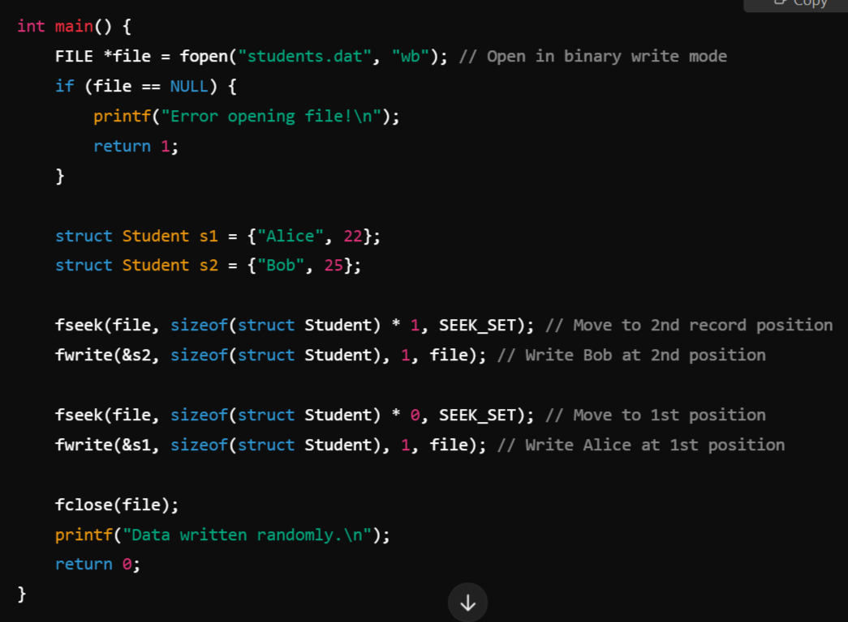


Slide 38
3️⃣ Reading Data Randomly
You can read a specific record by seeking to its position.
📌 Example – Reading a Specific Student Record
🔹 Explanation
fseek(file, sizeof(struct Student) * 1, SEEK_SET); moves to the 2nd record.
fread(&s, sizeof(struct Student), 1, file); reads that record.
Allows fast access without reading all previous records.

Slide 39
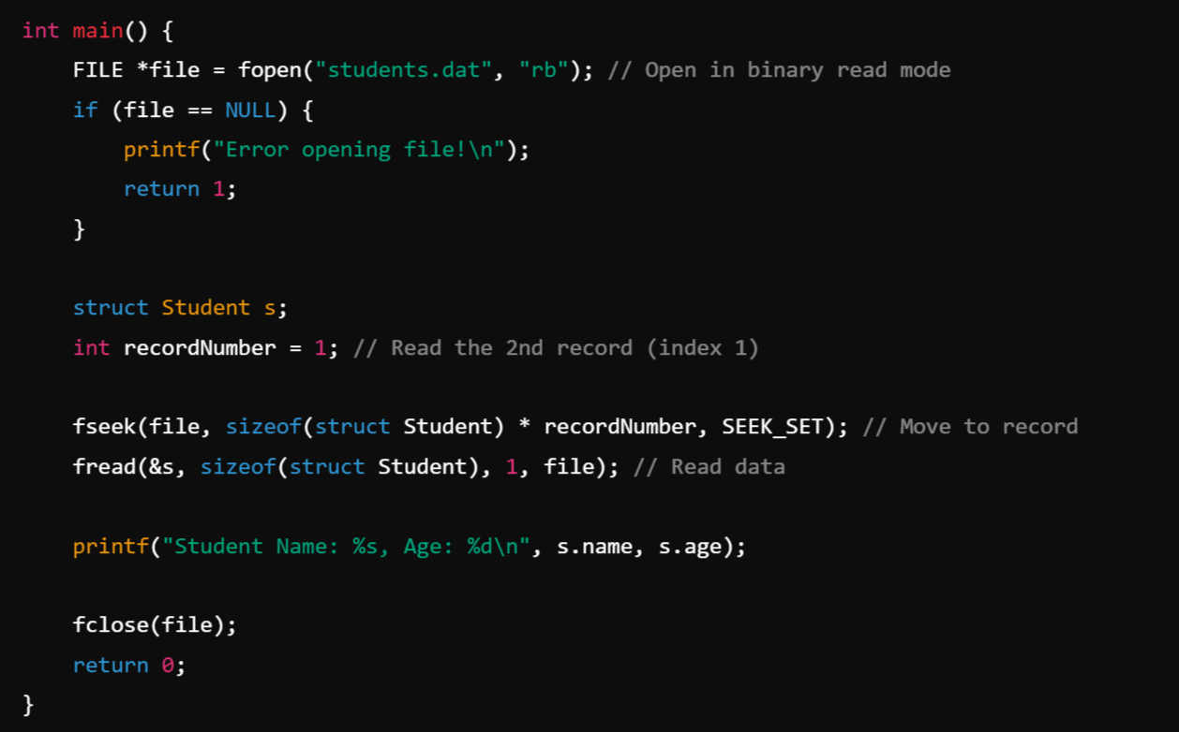

Slide 40
4️⃣ Updating Data Using Random Access
You can modify a specific record without rewriting the entire file.
📌 Example – Updating the Age of a Student
🔹 Explanation
Read the specific record.
Modify the data (s.age += 1).
Seek back and overwrite only that record.
Saves time compared to rewriting the whole file.

Slide 41
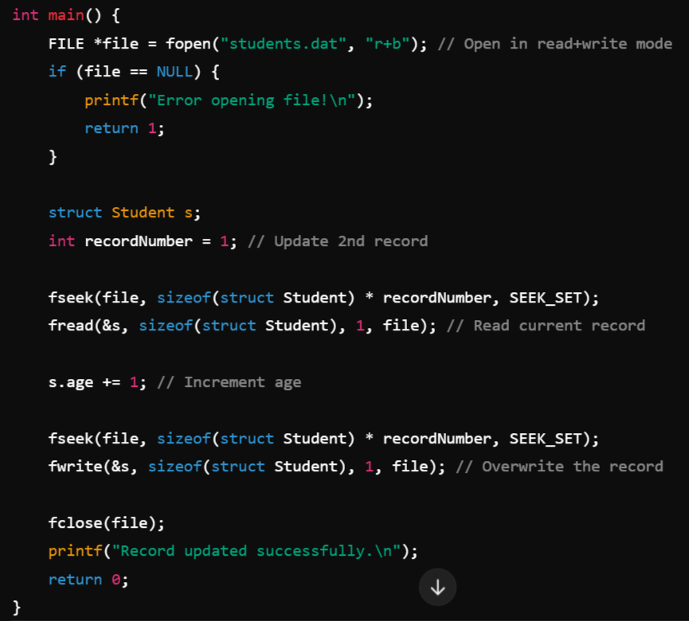
Example

Slide 42
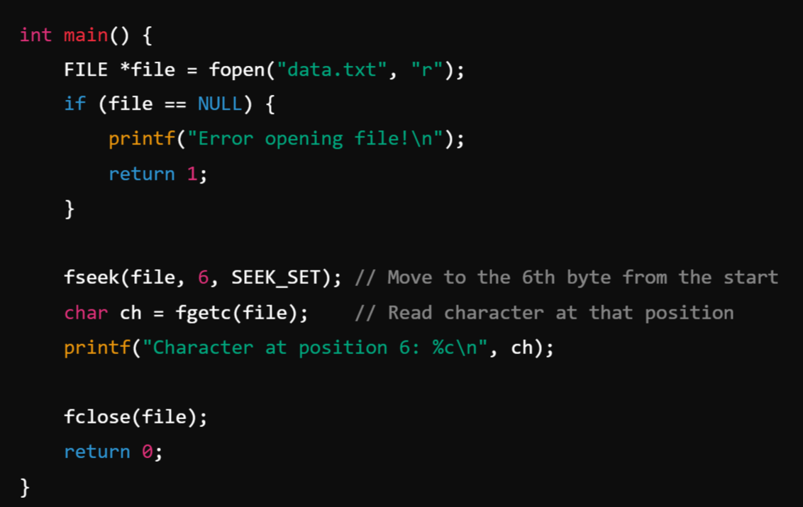
📌 Example – Seeking a Specific Position:
Explanation
fseek(file, 6, SEEK_SET) moves the file pointer to the 6th byte.
fgetc(file) reads a character from that position.

Slide 43

Command Line Arguments in C
Command-line arguments in C allow users to pass input values to a program when executing it from the terminal or command prompt. These arguments are passed to the main() function as parameters.
Syntax of Command Line Arguments
In C, the main() function can take two parameters:
argc (Argument Count): It represents the number of command-line arguments passed, including the program name.
argv (Argument Vector): It is an array of character pointers (strings) that hold the arguments.

Slide 44
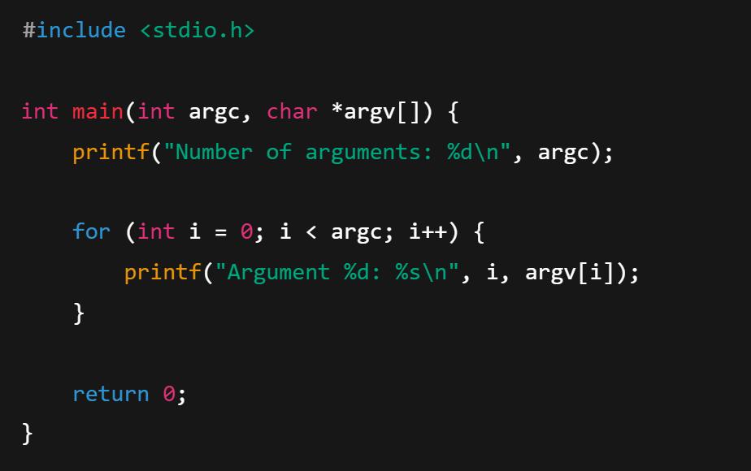
Example: Using Command Line Arguments

Slide 45
Syntax for Compiling and Running a C Program with Command Line Arguments
Compilation Syntax (Windows):
Example:

Slide 46
Execution Syntax (Windows):
Example:

Slide 47
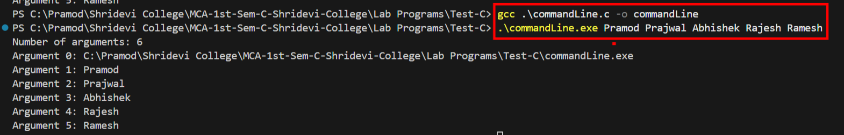
Output:
Note:
CommandLine Argument is another way of passing data to the program while it is running using Commmandline rather than using scanf() inside the program.

